Slide 1

Canadian Diplomatic Family Network
Survey Results
This presentation highlights the results of the survey conducted in the spring 2024 with 253 respondents from the family/dependents community
September 2024
Notes:
One of the key outcomes of the 2023-26 GAC Transformation Implementation Plan (“the Implementation Plan”) is “supporting deployment abroad: employees and their families posted abroad are supported effectively.”
The CDFN conducted several informal discussions with Canadian diplomatic partners and spouses which included identification of potential proposals related to this key outcome.
Participants were asked to provide information about their personal circumstances, evaluate their experience with employment, training, communication and community, financial, equity as diplomatic family members and provide feedback on 24 potential proposals to assist the CDFN in identifying the 10 priority proposals to inform the GAC the Implementation Plan. Respondents were also invited to write comments to share their personal experiences and concerns relating to the proposals.
Stats on community and respondents will be shared on the website. Keeping in mind we had ⅔ of respondents were posted abroad, early to mid career, with family.

Slide 2
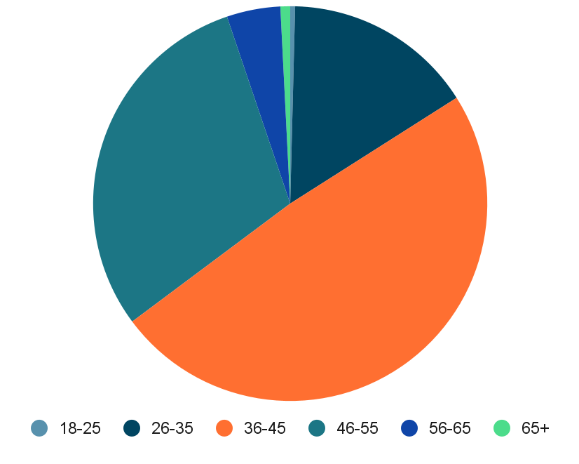
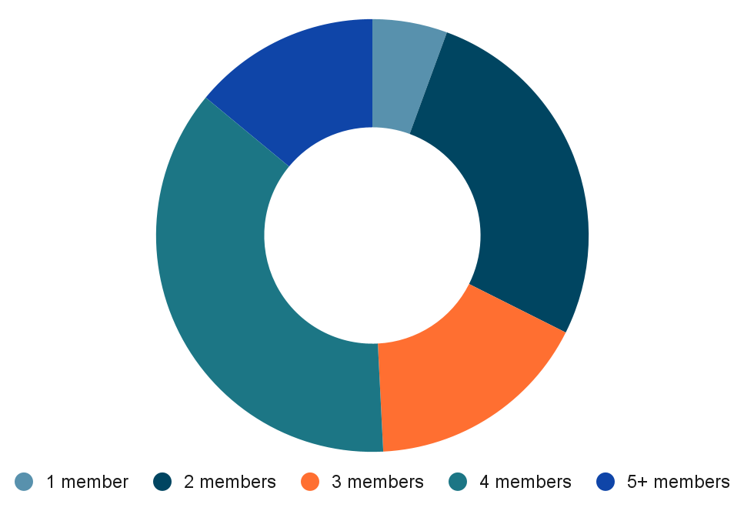
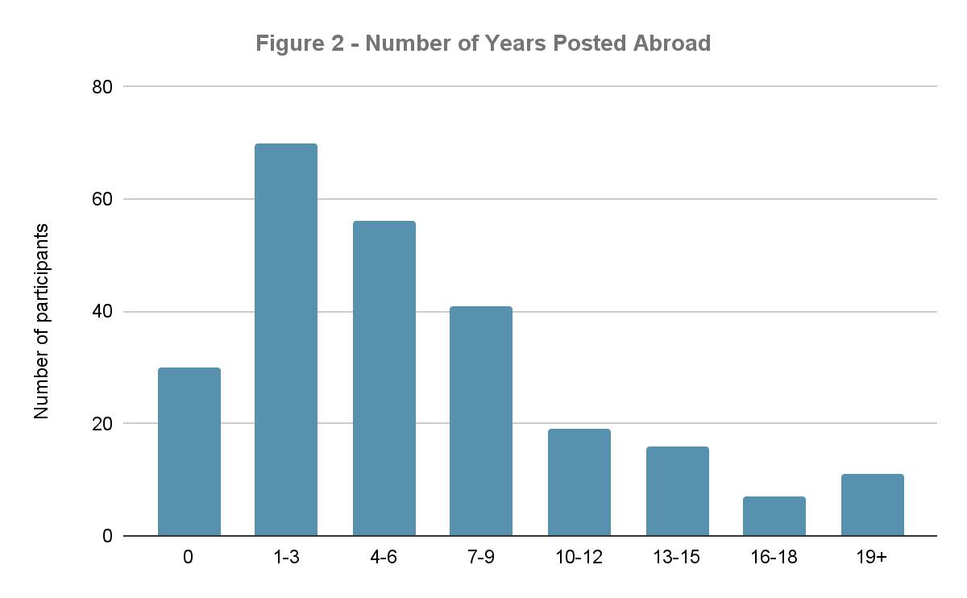
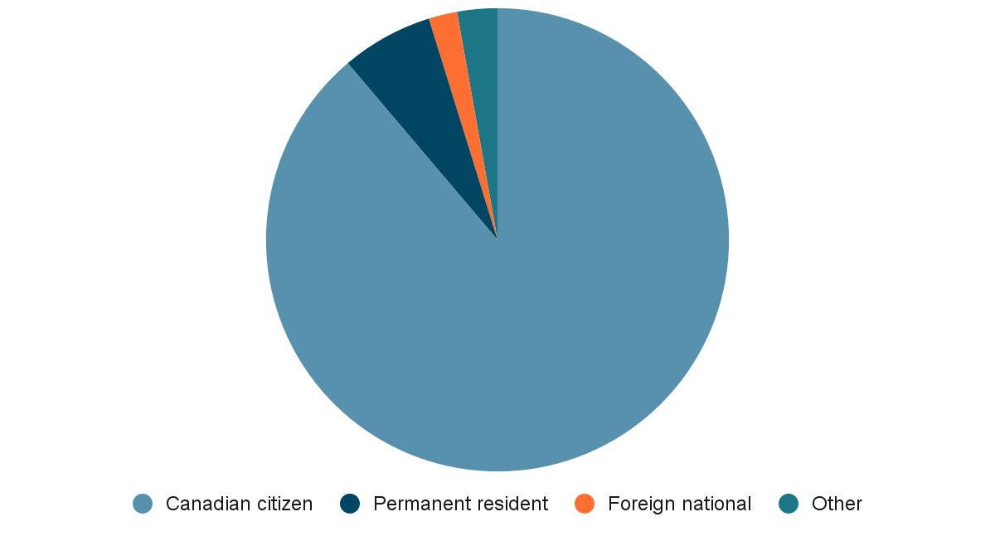
Getting to know the community
Age of respondents
# of Years Posted Abroad
Family configuration
Citizenship / Immigration status
Relation to the employee posted abroad
Community Self-Identification
Married
Common law partners
Unmarried
Other
2SLGTBQI+
Person with a disability
Visible minority
Canadian Indigenous
80.7%
17.6%
-
-
4%
3%
17%
2%
Notes:
Early/mid-career age of respondent & number of years abroad with other dependents (⅔)
Spouse & partners almost all respondents (98%)
Majority of Cnd cit (88%)

Slide 3
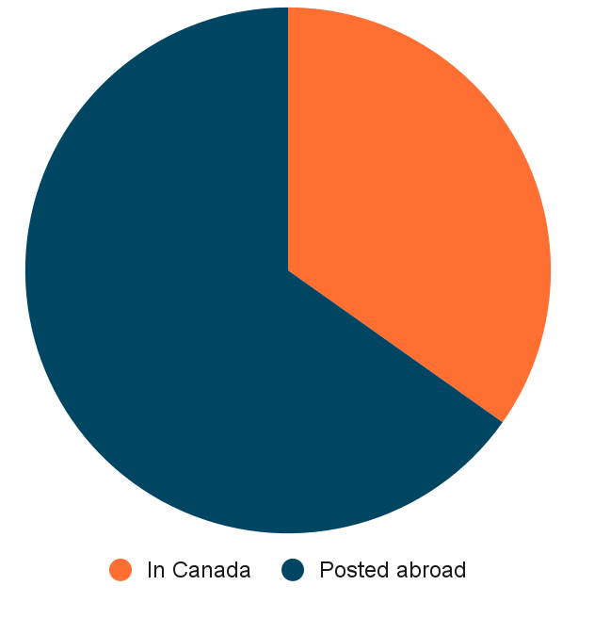
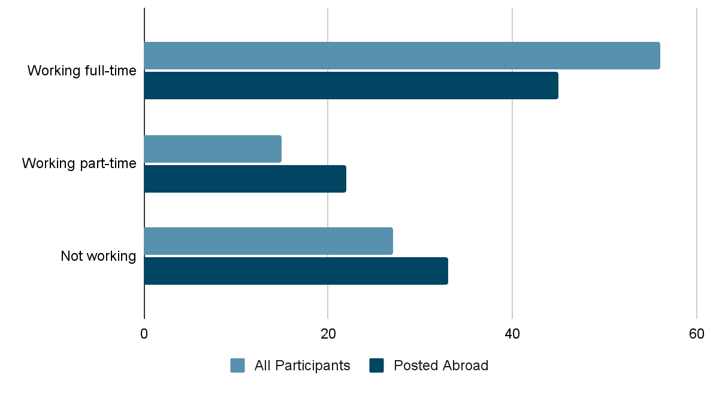
Getting to know the community (cont’d)
Employment
% of respondents currently posted abroad
% of respondents currently posted abroad working
21% Working in Canada
13% Working at a mission abroad
8% Working abroad but not at mission
14% Teleworking - government
4.5% Teleworking - non-government
9% Self-employed
– Volunteer
7% Not employed, not seeking to work
13% Not employed, actively seeking work
8% Others
Notes:
⅔ posted abroad
We wanted to compare overall response with only those working abroad because of long documented issues that posting impacts negatively employment prospects. 56 vs 46 for full time. More part-time work on post (15 vs 22) and more not working on post (27 vs 33)
Work situation for all responses, highest proportion of working in Canada (in Cnd post), working at missing, teleworking

Slide 4
Key Survey Findings - Highest and lowest ranked statements
“I can receive adequate support from the Spousal Employment Support Office (SESO)” - 92% disagreement
“On return from posting abroad to Canada, my partner’s employer provides information on employment opportunities in Canada” - 89% disagreement
“On return to Canada from posting abroad, my partner’s employer supports security clearance updates and/or language testing” - 87% disagreement
“There are adequate employment opportunities outside of the mission while on posting” - 84% disagreement
“There are adequate employment opportunities within missions abroad” - 84% disagreement
“There are adequate opportunities for foreign language training before or during a posting” - 81% disagreement
“Postings abroad have overall been a positive experience for me” - 53% agreement
“The prospect or reality of going on posting has adversely affected my mental health” - 48% disagreement
“The overall financial position of my partner and me has been negatively affected by going on postings” - 47% disagreement
“The prospect or reality of going on posting puts strain on my relationship with my partner” - 47% disagreement
“My partner’s employer adequately takes into account the considerations of 2SLGBTQI+ partners” - 46% agreement
“The process for being officially added to a posting as a common-law partner or aging parent is clear” - 33% agreement
Notes:
Second part of survey was to seek feedback from spouses/partners on their experience of being posted abroad in six different categories: employment, training, communication and community, finance, equity and general.
Asked to rate statement. Some statements were drafted in the negative so disagreement expressed by respondents indicates positive sentiment.
We only consider the responses in which participants rated statements from 1 (complete disagreement) to 5 (complete agreement) . Considered unanswered if omitted or rated as 0.
In green are the highest ranked statement, however does not mean “rosy situation” considering that only one had a majority of positive sentiment attached to it. Mostly attributed to statements looking at overall big picture of being posted abroad.
Lowest ranked in area of spousal employment with very high negative sentiment. Shows what we can improve one.
Breakdown of each statement, but in the interest of time, will not go through individually

Slide 5
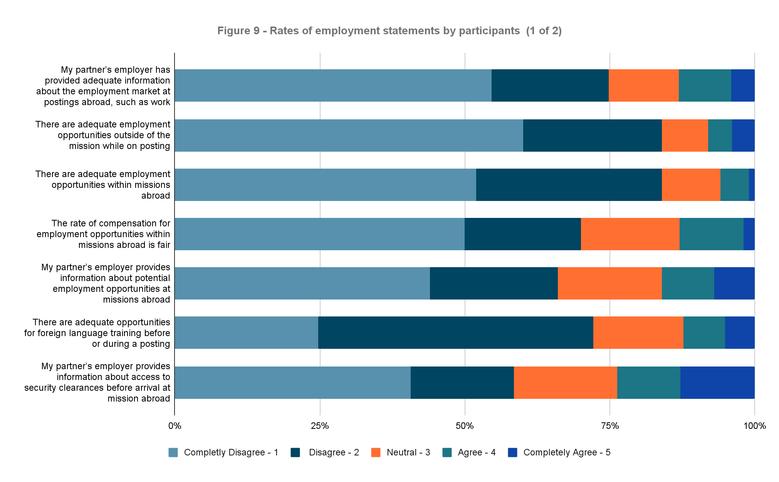
Key Survey Findings - Employment and training (1 of 2)
Notes:
Illustration of what the breakdown would look. Positive would be dark greenish and royal blue colours.

Slide 6
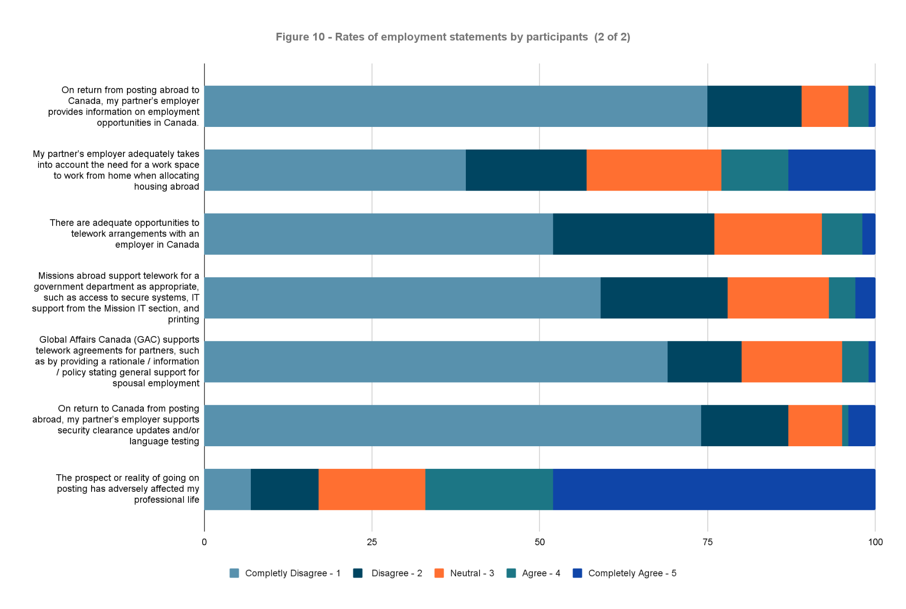
Key Survey Findings - Employment and training (2 of 2)

Slide 7
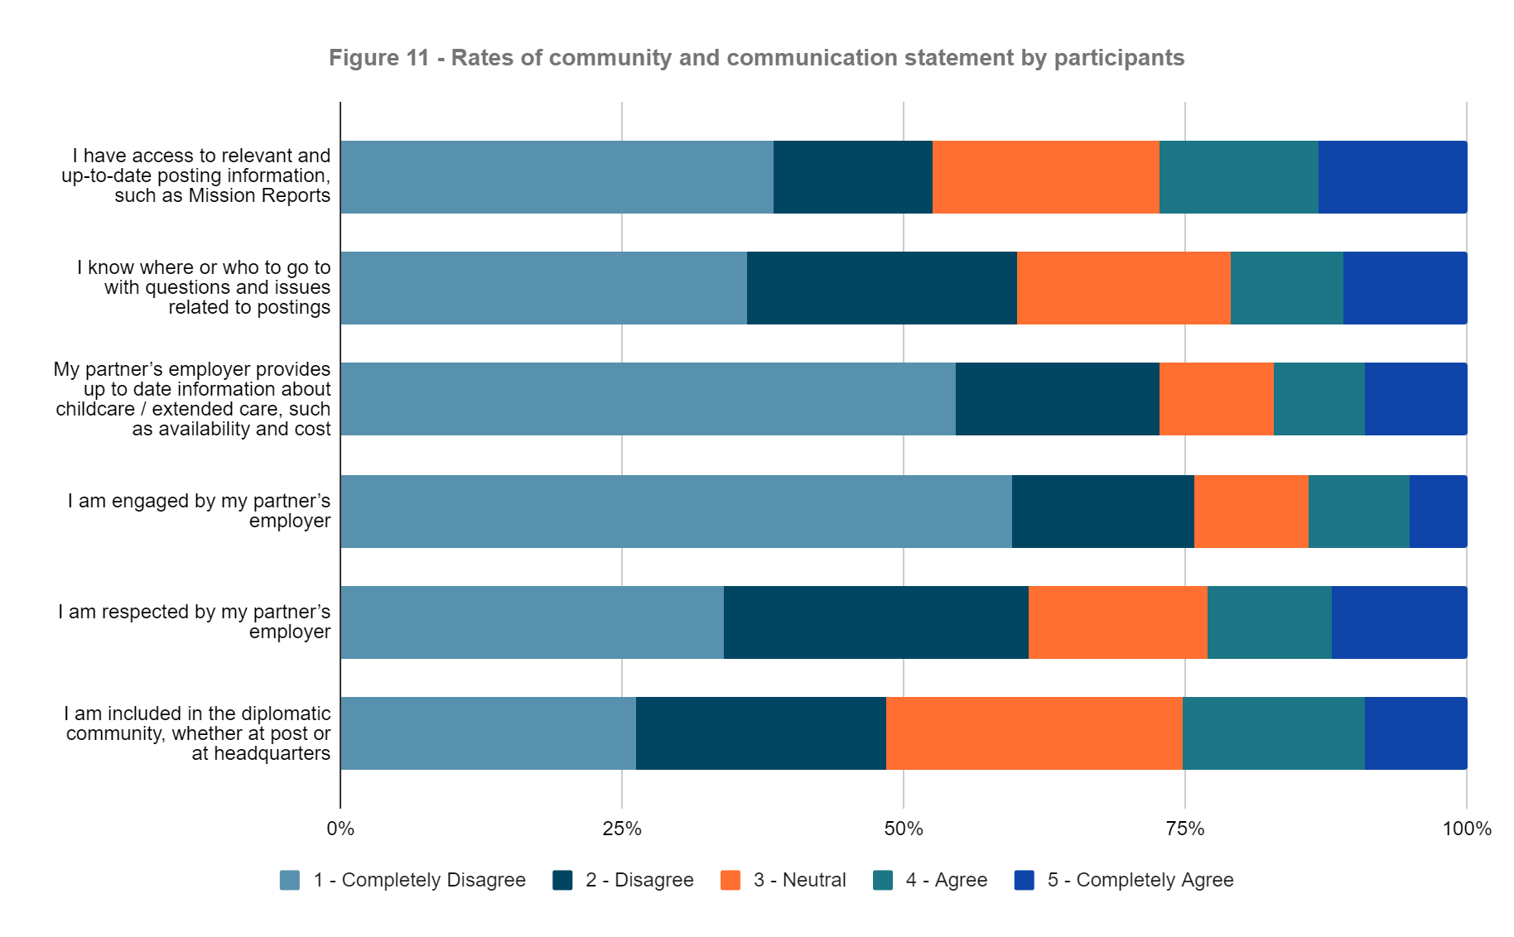
Key Survey Findings - Communication and community

Slide 8
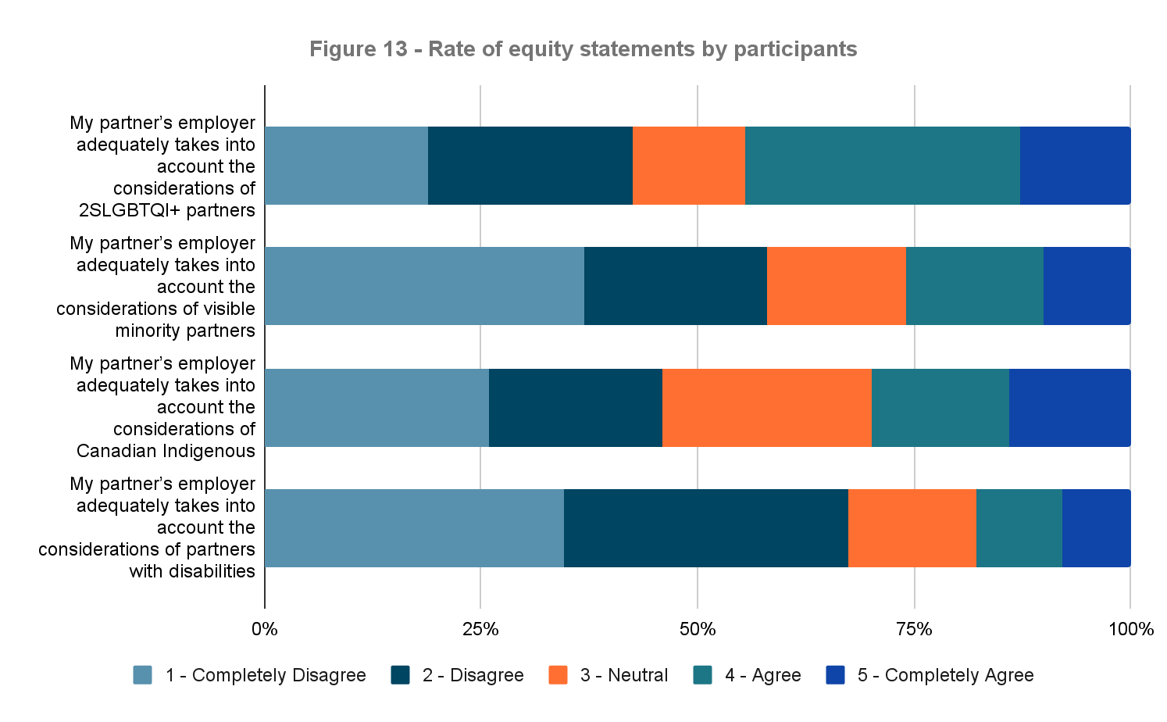
Key Survey Findings - Equity

Slide 9
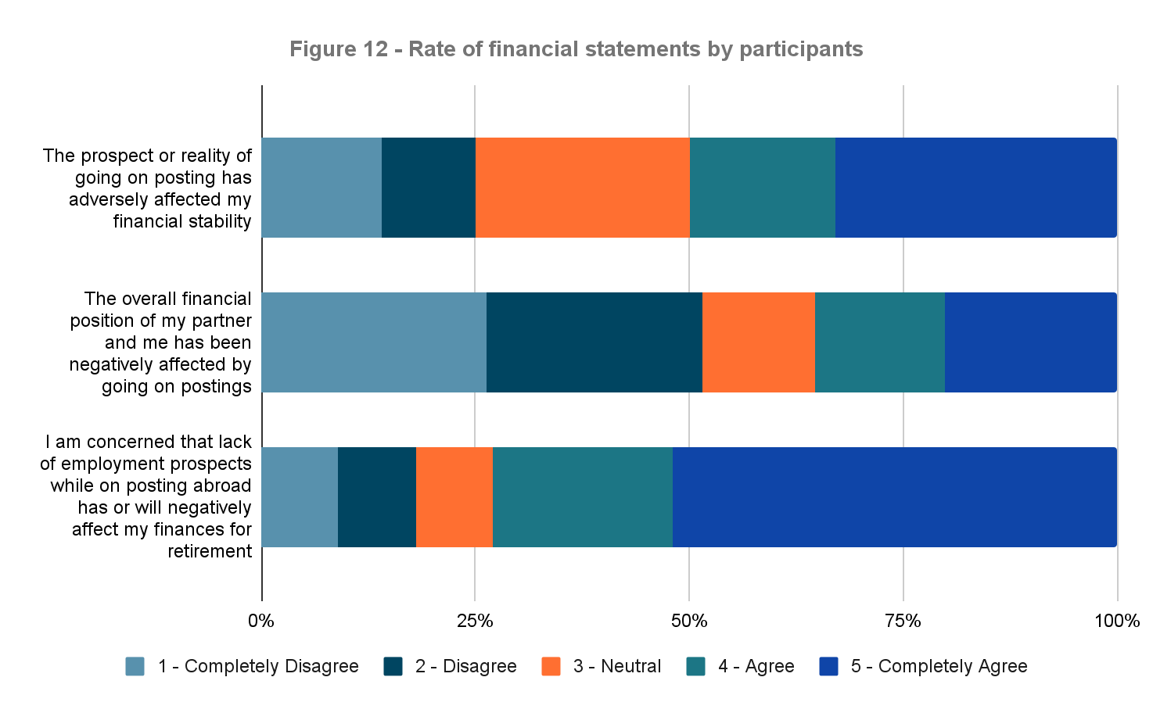
Key Survey Findings - Financial

Slide 10
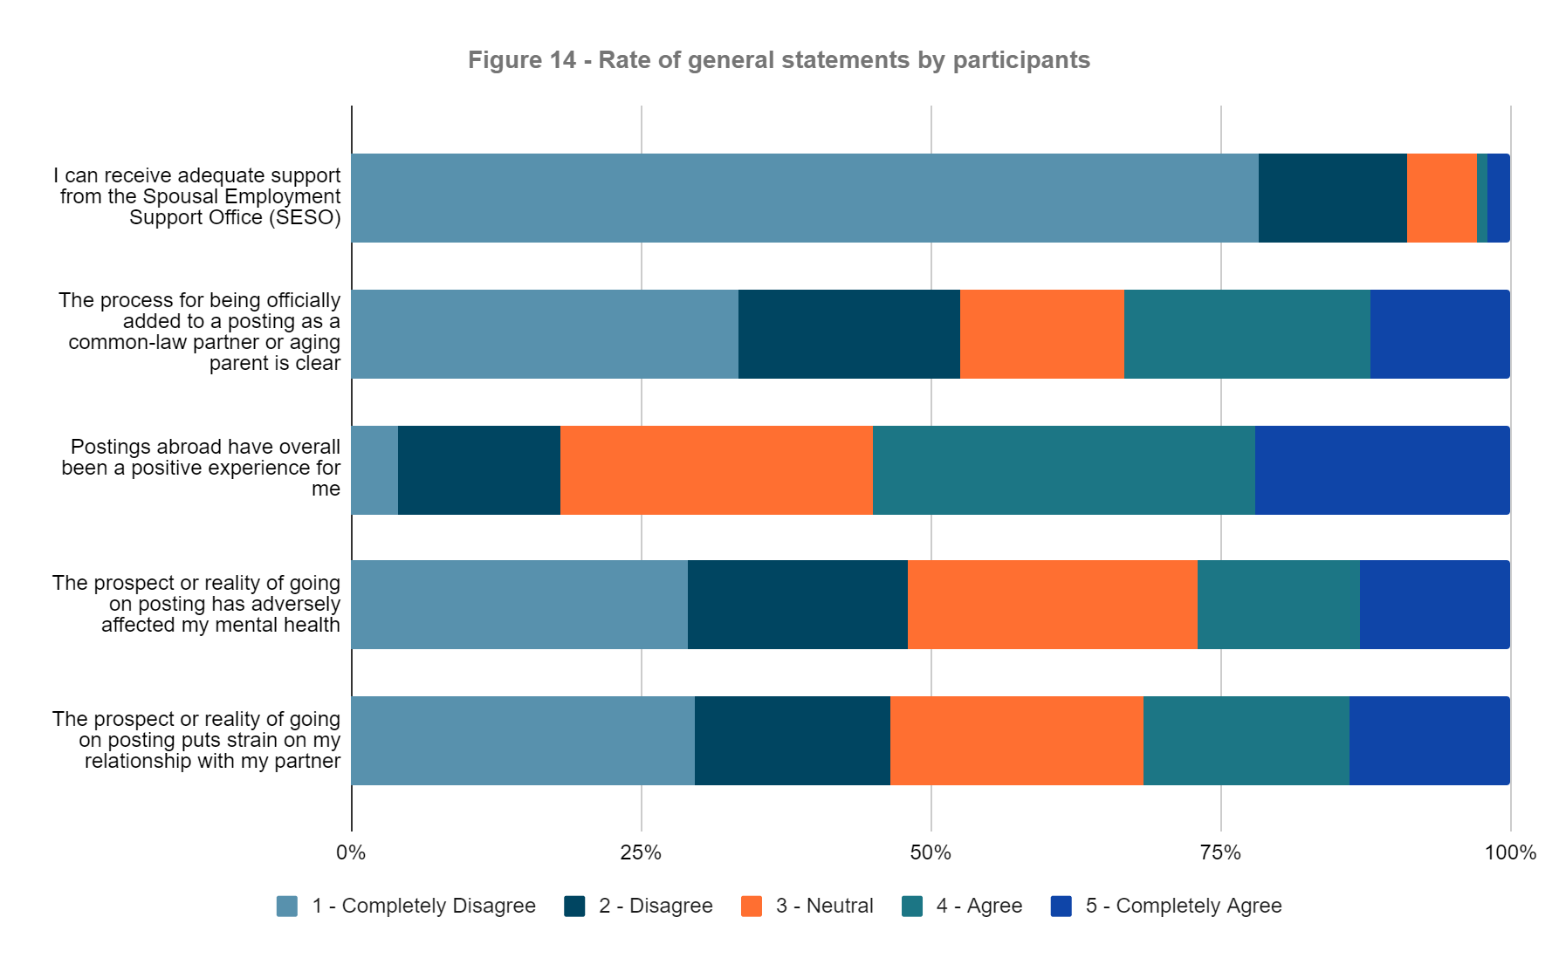
Key Survey Findings - General

Slide 11
Key Survey Findings - Top Proposals for Better Support
Creation of a formal qualified employment pool for partners and other family members of Canadians posted abroad, like the US “Foreign Service Family Reserve Corps”
Embassy employment contracts for partners and family members paid at the same rate of pay as if the work was being completed in Ottawa, rather than local employment rates of pay.
Access to foreign language training before and/or during a posting abroad
Priority access to embassy employment contracts for partners and family members who meet the minimum requirements of the job description
Creation of an officially recognized network / group for partners of Canadian diplomats abroad with representation in official discussions with the employer related to partners and families abroad
Funding for CPP/QPP contributions for partners who were previously employed but who became unemployed due to joining their partner on a posting
Improved support for telework arrangements with government departments in Canada
Creation of a communication portal for partners to access relevant information (e.g. Mission Reports) outside of the GAC intranet
Financial support for education / training (e.g. for career shifts)
Access to training before and during a posting through the Canada School of Public Service and other courses, including Passport Training
Access to French or English language training
Notes:
For this section, participants were asked to select their top 10 priorities to better support spouses or partners of Canadians who are posted abroad.
The most highly supported proposals can be categorized into four main groups: spousal employment; training; official representation and access to information; and retirement support.
Spousal employment: The single most highly supported proposal was “creation of a formal qualified employment pool for partners and other family members of Canadians posted abroad, similar to the US “Foreign Service Family Reserve Corps” (68.7%). Respondents commented that there are many highly qualified and educated partners abroad that could fill positions at missions at a much lower cost compared to TDs and employees at posting, noting the US model as cost-effective and popular with US colleagues.
The second most highly supported proposal was “embassy employment contracts for partners and family members paid at the same rate of pay as if the work was being completed in Ottawa, rather than local employment rates of pay” (65.7%). Respondents commented about having taken locally engaged staff (LES) contracts where the rate of pay was lower than Canadian minimum wage, as well as inconsistent approaches to pay for spousal contracts at different missions.
Other highly supported proposals in this category include: “priority access to embassy employment contracts for partners and family members who meet the minimum requirements of the job description” (57.6%), and “improved support for telework arrangements with government departments in Canada” (43.4%), with many respondents reporting significant barriers and differential treatment related to telework in the absence of an interdepartmental agreement for telework.
Training: The third most highly supported proposal was “access to foreign language training before and/or during a posting abroad” (64.7%), with respondents commenting on challenges with local integration while abroad in the absence of foreign language training. Other highly supported proposals in this category included “access to training before and during a posting through the Canada School of Public Service and other courses, including Passport Training” (40.9%); financial support for education / training (e.g. for career shifts)” (41.4%), and “access to French or English language training” (40.4%). Several comments noted that access to training for jobs at mission (particularly in relation to immigration and consular roles) would cut down on departmental TD costs.
Official Representation and Access to Information: 52% of respondents prioritized the “creation of an officially recognized network / group for partners of Canadian diplomats abroad with representation in official discussions with the employer related to partners and families abroad.” 42.9% of respondents prioritized the “creation of a communication portal for partners to access relevant information (e.g. Mission Reports, FSDs, MROs) outside of the GAC intranet.” A high number of comments related to diplomatic family members’ experiences of a feeling of loss of power, control, and respect; of needing to rely on their spouses to get basic information; and frustration with terms that are perceived to be demeaning such as “dependent” and “trailing spouse.”
Retirement Support: 48% of respondents prioritized “funding for CPP/QPP contributions for partners who were previously employed but who became unemployed due to joining their partner on a posting.” This is perhaps best illustrated by this comment: “I sacrificed career and income potential, but the rub is that at the end of his career, if my spouse dies I only get half the pension but have pretty much nothing of my own because of following him around.”

Slide 12
Selected Comments from respondents
“Embassies could save so much money compared to TDs and employees at a posting when there are already qualified spouses living in the country who want to work. Spouses are a valuable untapped resource! We are here and we want to work!”
“Access to training for jobs at mission (such as immigration or passport officer jobs) should be provided and encouraged, and would cut down on departmental TD costs. This could be done before or during a posting. Same with language training.”
« La création d'un point d'accès unique pour toute les questions que pourrait avoir le/la partenaire d'un.e Canadien.ne en affectation à l'étranger, spécialement lors de la première affectation, lorsque tout est nouveau. Que ce soit pour répondre à des questions en lien avec les possibilités d'emploi, les assurances, la santé (incluant santé mentale), à l'éducation des enfants, etc. Nous avons trouvé beaucoup de réponses à nos questions (mais pas toutes) en parlant avec d'autres. »
“We need help for integration for dependents when moving to a foreign country where they do not know anyone and have no support. The Community Liaison Officer role back the day was very helpful as they provided useful relevant information before and during a posting. They also brought families together with other expats.”
“We have had equal rights to marriage for long enough that Canada should be supporting us fully when countries will have a policy that will put us in harms way when our careers bring us to places where Canada has work to do. Being Canadian and proudly a member of the LGBT+ community. We are strong as a country when we truly support those who work hard for Canadian interests abroad.”
“We need interdepartmental agreements for teleworking. We had spouses who worked for all sorts of other government departments, and none were able to secure a teleworking agreement for the duration of the posting.”
“Spouses abroad suffer from lack of employment opportunities as well as in my case zero retirement benefits on returning to Canada. This is after 20 years of continuous travel abroad. We were forced to always choose hardship posting to try to put money aside for spousal retirement. It’s exciting being abroad, but it does have a significant amount of financial stress attached to it.”
“We need a job database for spouses inside and outside of the mission, including teleworking opportunities. Many officials receive job posts from international organizations that would be good to share with spouses looking for jobs at post.”
« J'ai dû démissionner de mon poste permanent au Canada dû aux affectations de mon mari. Cela a eu un énorme impact financier et psychologique. Le traitement des conjoints à l'étranger est médiocre. J'ai eu souvent l'impression d'être qu'un numéro et que mon bien-être n'est pas une priorité. Le manque de formation linguistique et d'une communauté canadienne à l'étranger développe l'isolation et à des impacts importants sur le conjoint et le reste de la famille. »
“One of the core issues is limiting and removing control (and respect) from educated and intelligent spouses who are trying to make the best decisions for their families. Those with the best intentions for postings are often finally disillusioned and beaten down by the lack of respect and acknowledgement by GAC.”
“I sacrificed career and income potential, but the rub is at the end of his career, if my spouse dies I only get half the pension but have pretty much nothing of my own because of following him around.”
Notes:
Leaving with a selection of comments from respondent
Next steps are to share these results with the community - summary format and a more fulsome report with more detailed breakdown.

